Slide 1


K.RAMAKRISHNAN COLLEGE OF ENGINEERING (Autonomous) Accredited by NAAC with - 'A' Grade, NBA Accreditation of EEE DEPARTMENT OF ELRCTRICAL AND ELECTRONICS ENGINEERING
BATCH NO : 14
A WIRELESS BASED AUTHENTICATION OF WEAPONS AND ITS CONTROL SYSTEM
GUIDED BY
A.SUBRAMANIYA SIVA.,M.E.,(Ph.D.,)
Assistant HOD/EEE
Electrical and Electronics Engineering
K . Ramakrishnan College of Engineering,
(Autonomous) Tiruchirappalli – 621 112
1

Slide 2
A WIRELESS BASED AUTHENTICATION OF WEAPONS AND ITS CONTROL SYSTEM
PRESENTED BY
NAVEEN RAJ T -8115U21EE034
NAWIN KRISH S - 8115U21EE035
KARTHIKEYAN P - 8115U21EE302
PRASANNA VENKATESAN T - 8115U21EE304
Department of Electrical and Electronics Engineering
Third Year / 6th Semester
K.RAMAKRISHNAN COLLEGE OF ENGINEERING
(Autonomous)
2

Slide 3
INTRODUCTION
A wireless-based weapon authentication and control system offers enhanced security by enabling real-time verification, reducing the risk of unauthorized access.
It promotes safer weapon handling through rfid authentication, limiting usage to authorized individuals and enhancing overall public safety.
Additionally, wireless connectivity allows for efficient data management, instant updates, and remote monitoring, contributing to a more responsive and accountable firearm control infrastructure.
3

Slide 4
OBJECTIVE AND SCOPE
The objective of a weapon authentication and control system based on wireless technology is to enhance security by ensuring that only authorized personnel can access and use the weapons.
The scope includes implementing robust authentication mechanisms, real-time tracking, and remote control features
To prevent unauthorized use and enhance overall safety in military or law enforcement settings.
4

Slide 5
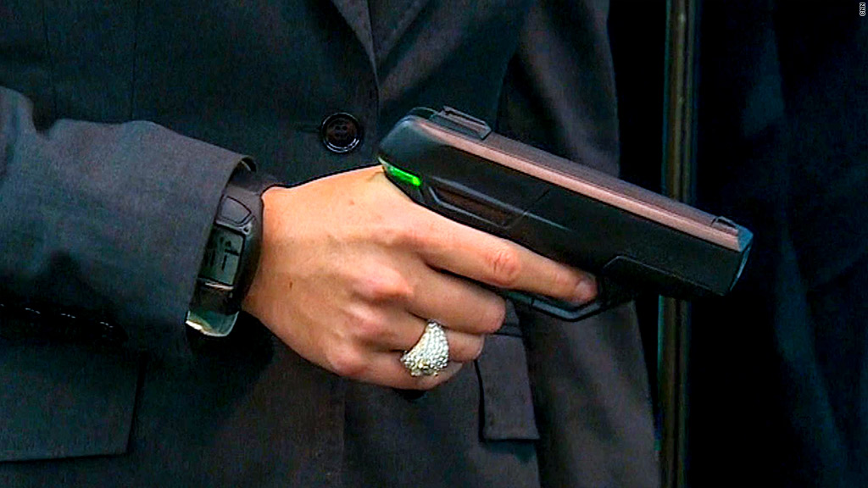
BASIC CONCEPTS
Using secure wireless communication protocols to transmit authentication data between the weapon and a centralized control system.
Additionally encryption ,GSM and robust security measures are crucial to prevent unauthorized access or tampering with the system.
5

Slide 6
LITERATURE
S.NO | NAME | YEAR | DESCRIPTION
1. | C . A . Devi | 2014 | They implemented RFID, Palm image in gsm using AT89S51 in RS232 cable
2. | Usha Jain,Muzzammil Hussain | 2020 | Using Resilient Authentication Mechanism
6

Slide 7
COMPONENTS USED:
1.ARDUINO UNO
2.LCD-DISPLAY
3.GSM
4.KEYPAD (4*3)
5.RFID
6.RELAY SWITCH
7.POWER SUPPLY CONVERTER
7

Slide 8
BLOCK DIAGRAM
RF CARD
RF READER
MICROCONTROLLER
GSM
KEYPAD
RELAY
LED
LCD
8

Slide 9
CIRCUIT DIAGRAM
9

Slide 10
ARDUINO UNO
Definition : The Arduino Uno is a popular microcontroller board based on the ATmega328P microcontroller. It is the flagship board of the Arduino platform and is widely used in hobbyist projects, prototyping, and education.
Microcontroller : The heart of the Arduino Uno is the 8 bits ATmega328P microcontroller, which contains a CPU, memory, digital and analog I/O pins, timers, and communication interfaces.
I/O Pins: The Arduino Uno has a total of 14 digital input/output (I/O) pins, of which 6 can be used as PWM (Pulse Width Modulation) outputs, and 6 analog input pins.
Power Supply: The board can be powered via a USB connection or an external power supply (7-12V DC). It has an onboard voltage regulator that provides a stable 5V supply for the microcontroller and other components.
10

Slide 11
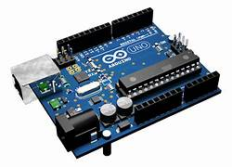
USB Interface: The Arduino Uno features a USB interface that allows it to communicate with a computer for programming and serial communication. It uses a standard USB Type-B connector.
Program Memory: The ATmega328P microcontroller on the Arduino Uno has 32KB of flash memory, of which around 0.5KB is used by the bootloader.
Clock Speed: The microcontroller operates at a clock speed of 16 MHz, providing sufficient processing power for a wide range of applications.
Programming: Arduino Uno can be programmed using the Arduino Integrated Development Environment (IDE), which is based on the C and C++ programming languages
11

Slide 12
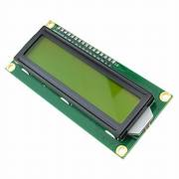
LCD DISPLAY
Size: The term "16x2" refers to the dimensions of the LCD display, indicating it has 16 characters per row and 2 rows of characters.
Technology LCD (Liquid Crystal Display) technology : They consist of liquid crystal molecules sandwiched between two polarized glass layers.
Character Capacity: With 16 characters per row and 2 rows, the display can show up to 32 characters simultaneously.
Voltage Requirement: LCD displays usually require a specific voltage level to operate, often in the range of 3.3V to 5V DC
12

Slide 13
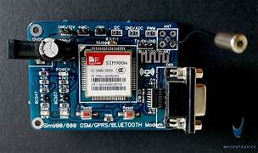
GSM-Global System For Mobile Communication
Call Initiation: A GSM-enabled device dials a number.
Tower Connection: The device connects to the nearest GSM tower.
Authentication: The tower verifies the device's identity and user credentials.
Call Routing: The tower routes the call to the recipient's network or device.
Transmission: Voice or data is transmitted via the GSM network.
Recipient Connection: The recipient's device receives the call or data.
Communication: Conversation or data exchange occurs between devices.
Call Termination: Either party ends the call, and the connection is terminated.
13

Slide 14
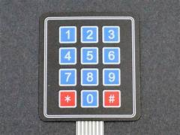
KEYPAD 4*3
A 4x3 keypad is a grid of buttons arranged in 4 rows and 3 columns, typically used for inputting numbers or characters. Each button represents a unique combination of row and column, allowing for specific inputs when pressed.
For example, pressing the button in the first row and first column would produce one output, while pressing the button in the second row and third column would produce a different output. This grid layout enables users to input data efficiently by pressing the corresponding button for each desired character or number.
14

Slide 15
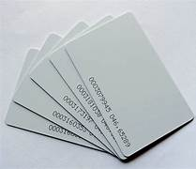
RFID-Radio Frequency Identification
Tag Detection: An RFID reader emits radio waves.
Tag Response: RFID tags within range detect the signal and respond with their unique identification information.
Data Transmission: The reader captures the tag's ID and may transmit it to a computer system.
Identification: The system processes the ID to identify the tagged object or individual.
Applications: RFID is used for tracking inventory, access control, payment systems, and more.
15

Slide 16
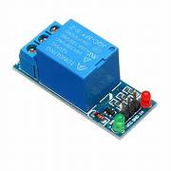
RELAY SWITCH
Input Signal: A low-voltage signal triggers the relay switch.
Electromagnetic Coil: The signal energizes the coil, creating a magnetic field.
Contact Closure: The magnetic field pulls the relay's contacts together, completing the circuit.
Circuit Activation: The activated circuit powers up, carrying out its intended function.
Release: When the input signal is removed, the coil de-energizes, and the contacts return to their original position, interrupting the circuit.
Reset: The relay is ready for the next activation.
16

Slide 17
POWER SUPPLY CONVERTER
Input Stage: Takes in AC or DC power.
Rectification: Converts AC to DC.
Switching Stage: Rapidly switches DC voltage.
Transformation: Alters voltage using a transformer.
Regulation: Maintains stable output voltage.
Output Stage: Delivers regulated DC power to the load.
Protection: Safeguards against overvoltage, overcurrent, and
overheating.
17

Slide 18
CONCLUSION
In today's world technology has advanced to great extent.
Many concept which were impractical to hear have now become reality.
In this modern world developing smart weapons would be a hope for better future.
In future illegal training of weapons may come to an end.
Developing smart weapons will also help armies & federal bodies in fighting crimes in better ways
18

Slide 19
FUTURE SCOPE
Enhanced Biometrics: Integration of advanced biometric authentication methods such as iris recognition or facial recognition for heightened security and accuracy.
AI-Powered Threat Detection: Implementation of artificial intelligence algorithms to analyze user behavior patterns and detect potential threats or unauthorized usage in real-time.
Blockchain Integration: Utilization of blockchain technology for secure and tamper-proof storage of weapon usage data, ensuring transparency and accountability.
5G Connectivity: Leveraging 5G networks for ultra-low latency and high-speed communication between weapons and control systems, enabling faster response times and improved reliability.
Geofencing: Implementation of geofencing technology to define virtual boundaries for weapon usage, ensuring that weapons can only be activated within designated areas or under specific conditions
19

Slide 20
REFERENCE
1.https://www.researchgate.net/publication/341906602_Securing_Wireless_Sensors_in_Military_Applications_through_Resilient_Authentication_Mechanism
2.https://www.researchgate.net/publication/326787625_Design_and_Implementation_of_Wireless_Communication_System_for_Weapon_Setting
3.Henry.E, Classification and Uses of Fingerprints. London, U.K.: Routledge, 1900
4. Joachims.T, “Optimizing search engines using clickthrough data,” in Proc. 8th ACM SIGKDD, 2002, pp. 133 –142.
5. Lumini .A, D. Maio, and D. Maltoni, “Continuous vs. exclusive classifi- cation for fingerprint retrieval,” Pattern Recognit. Lett., vol. 18, no. 10, pp. 1027–1034, Oct. 1997.
20

Slide 21
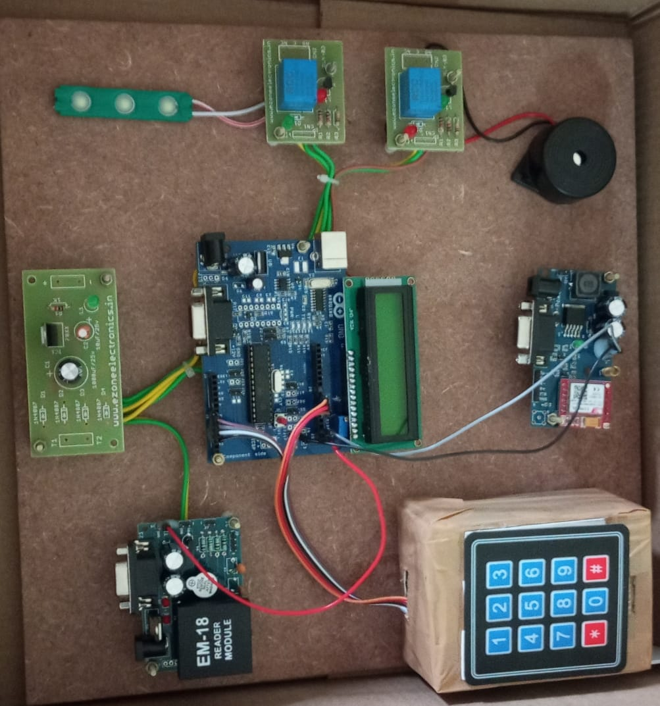
PROTOTYPE
21

Slide 22
PROJECT VIDEO LINK
https://drive.google.com/file/d/1j3hAExwK41x-gHVQGbLvMAs_HofkgE-V/view?usp=drivesdk
22

Slide 23

23

